Slide 1

British Airways Virtual Internship (Data Science)
Web Scrapping : Data Extraction (Data Gathering) and Data Analysis.
Analysing the Customer Behaviour based on their reviews

Slide 2
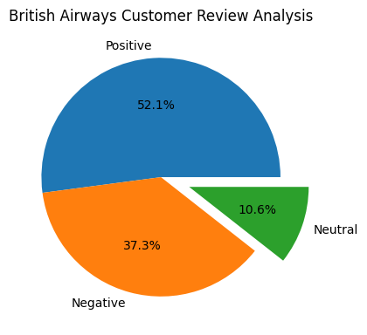
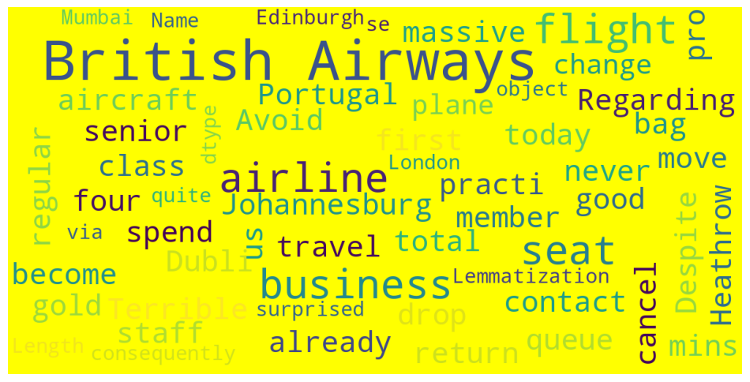
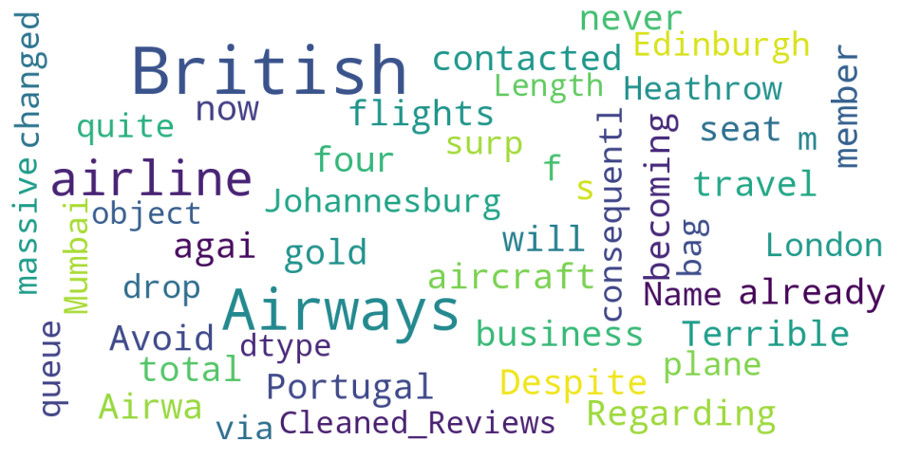
Customer Review Analysis
Number of Positive Reviews : 521
Number of Negative Reviews : 373
Number of Neutral Reviews : 106
Number of Trips Verified : 813
Number of Not Verified : 187

